Slide 1
BOSTON UNIVERSITY Senior Research Assistant and Programmer Search February 2022
Candidate Name: Shuang Song

Slide 2
AAU Doctoral Exit Survey – DEI Analysis
With the AAU, we seek to better understand the experience of our PhD students
Hope to use survey results to improve PhD student experience at University A.
Since its inception, the Doctoral Exit Survey has achieved close to a 90% response rate
The DEI Analysis includes data from January 2019-September 2021
For the purposes of the DEI analysis, respondents were classified as “Underrepresented” or “Non-Underrepresented” by their responses to the race/ethnicity questions in the survey

Slide 3
The Term ‘Under-Represented Group’
In this presentation and analysis, the term ‘Under-Represented Group’ pertains to those student respondents who have self-identified as ‘American Indian or Alaska Native,’ ‘Black or African American,’ ‘Hispanic or Latino,’ and ‘Native Hawaiian or Other Pacific Islander.’ Students who identified as ‘Two or More Races’, that included at least one of the categories listed above, were also classified as “Underrepresented.”
These students are aggregated together because their low representation in the dataset would make it difficult to draw comparisons and important conclusions that might influence future policies and programs relevant to UA’s efforts in promoting and sustaining Diversity, Equity, and Inclusion.
Due to a recent change in UA’s current internal policy (which is still under formulation), we have been advised by AS&IR to no longer use the term ‘Under-Represented Group’ until further resolution.
Since this presentation was prepared prior to this advisement, we have retained the usage of this term. As soon as a decision is made on final terminology and definitions, we will update our presentations, as appropriate.

Slide 4
Under-Represented Students
Students who are classified as “Under-Represented” in this analysis include:
African American/Black Students
Hispanic/Latino Students
American Indian or Alaskan Native Students
Native Hawaiian or Pacific Islander Students
NOTE: Students who identified as two or more races, including at least one of the categories listed above, were also classified as “Underrepresented.” International students were excluded from the analysis.
Notes:
Two or More Races category includes:
Three students who identify as both black and white
One student who identifies as both NHPI and white
One student who identifies as both AIAN and white
One student who identifies as Asian, NHPI, and White
One student who identifies as AIAN, Asian, and White

Slide 5
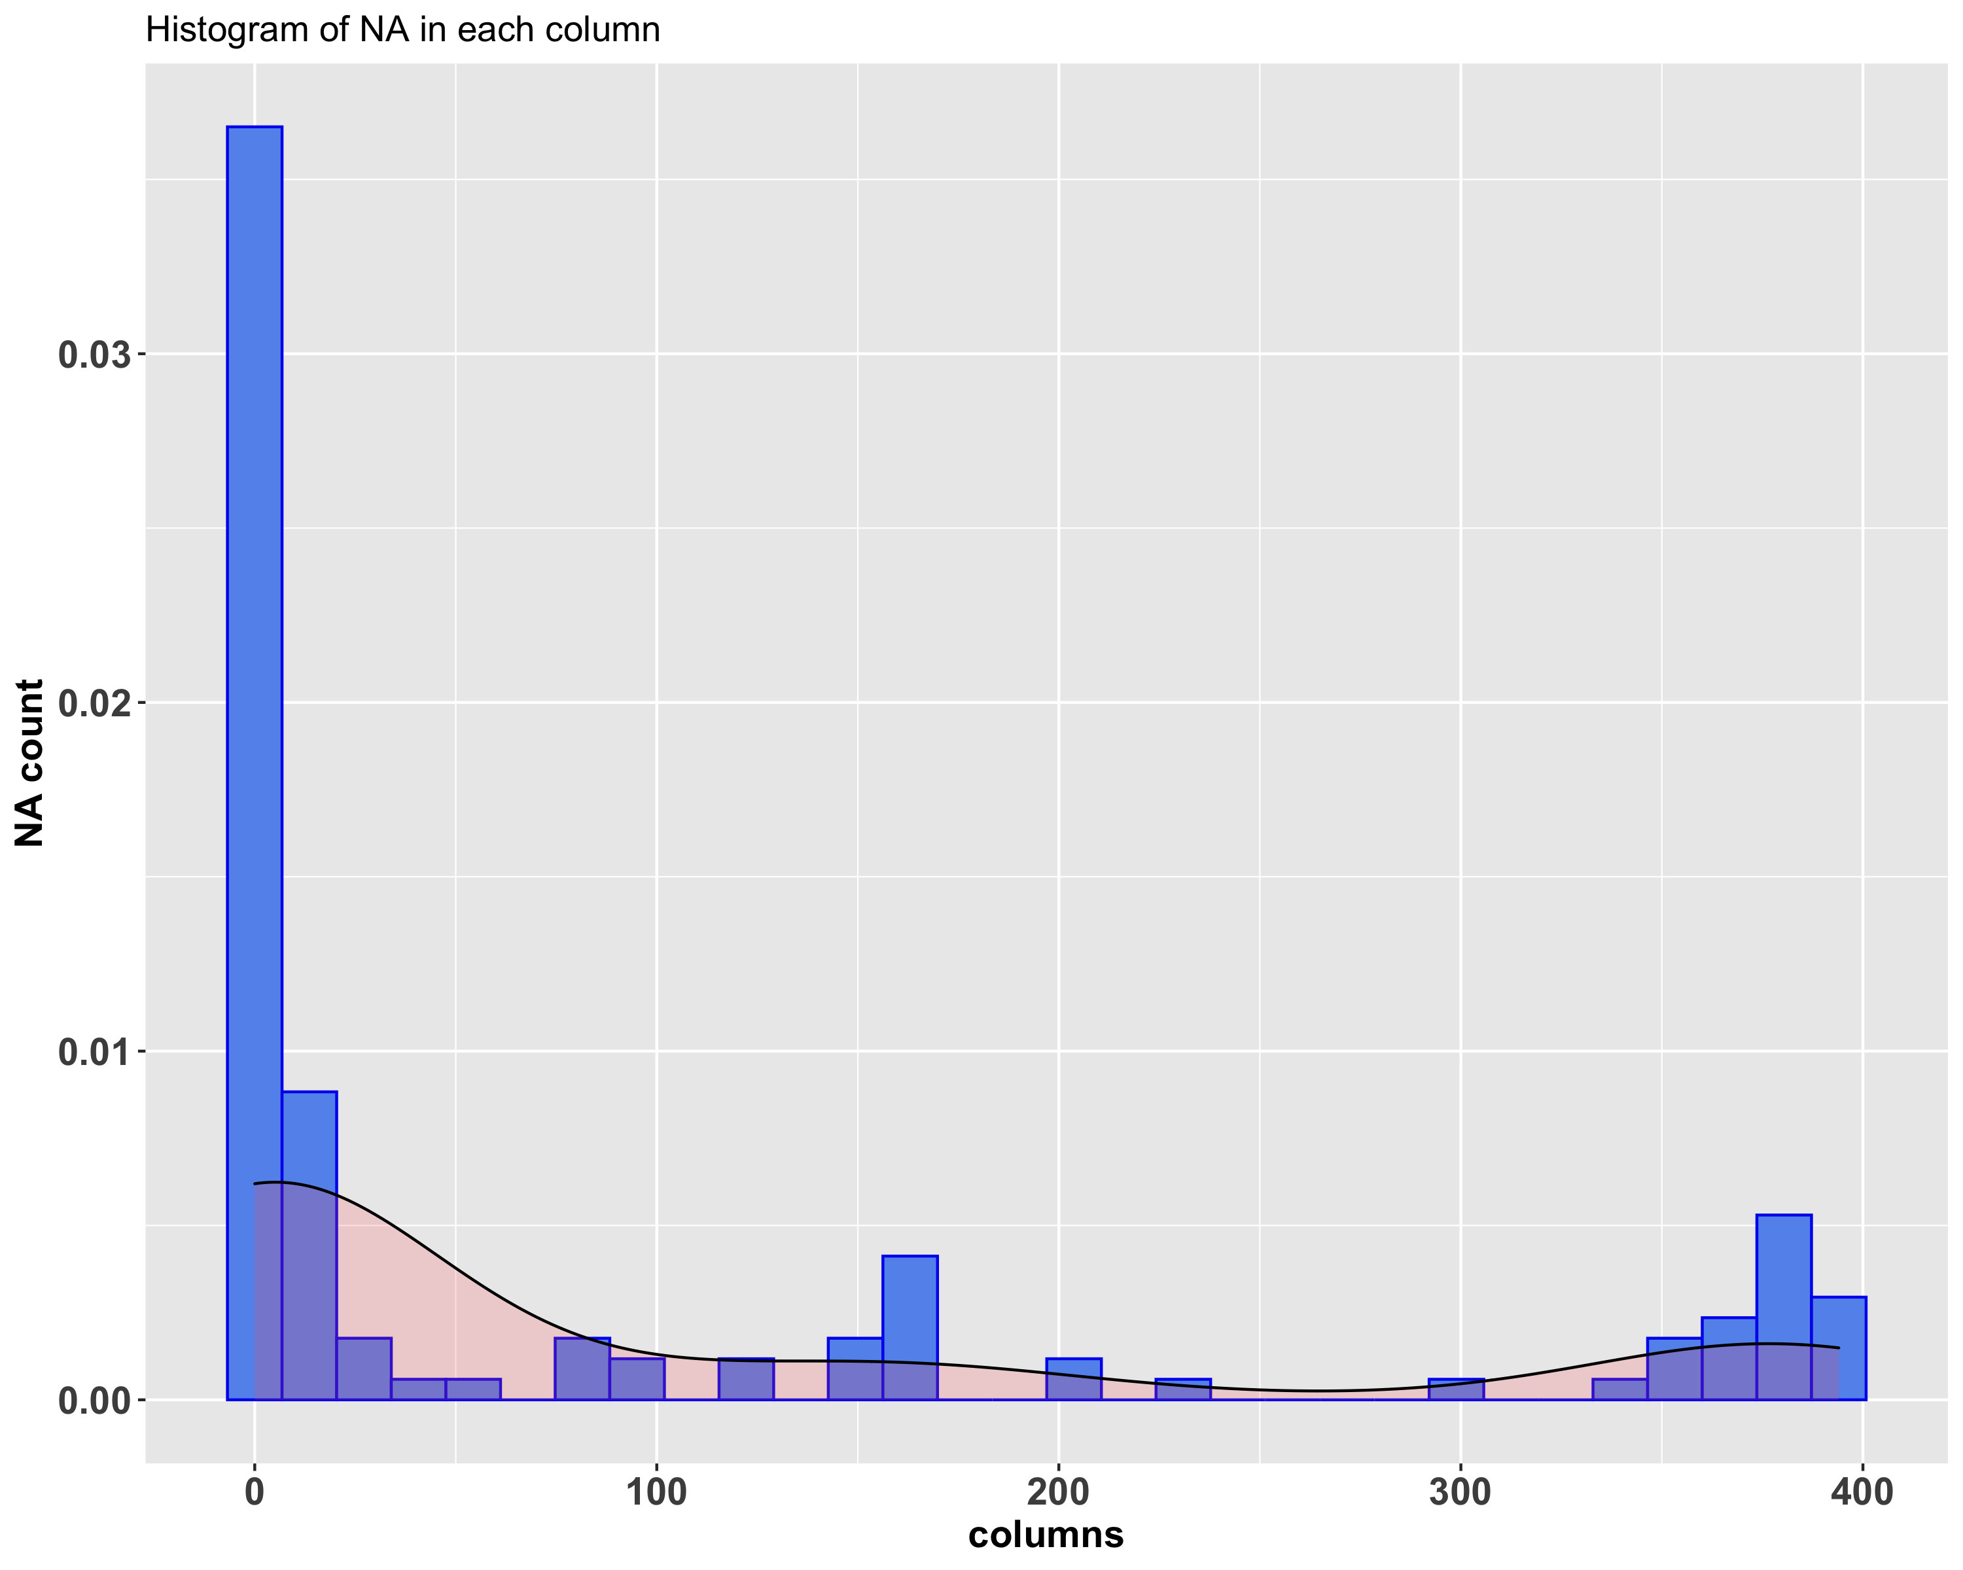
Data Highlights
Type | rows | columns
Raw data | 668 | 125
Exclude International student | 400 | 125
Density graph shows the distribution of NA numbers in each columns

Slide 6
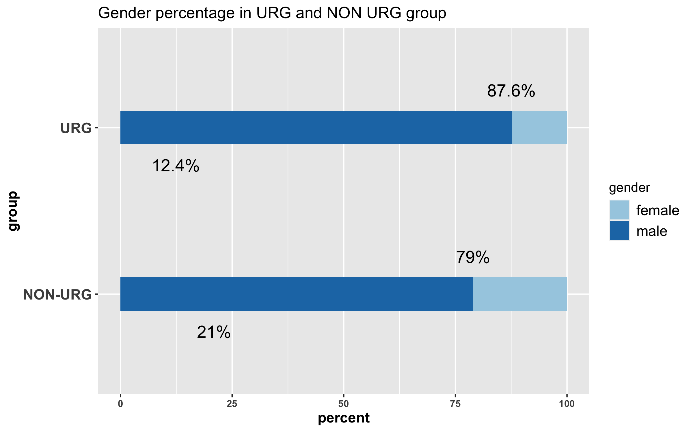
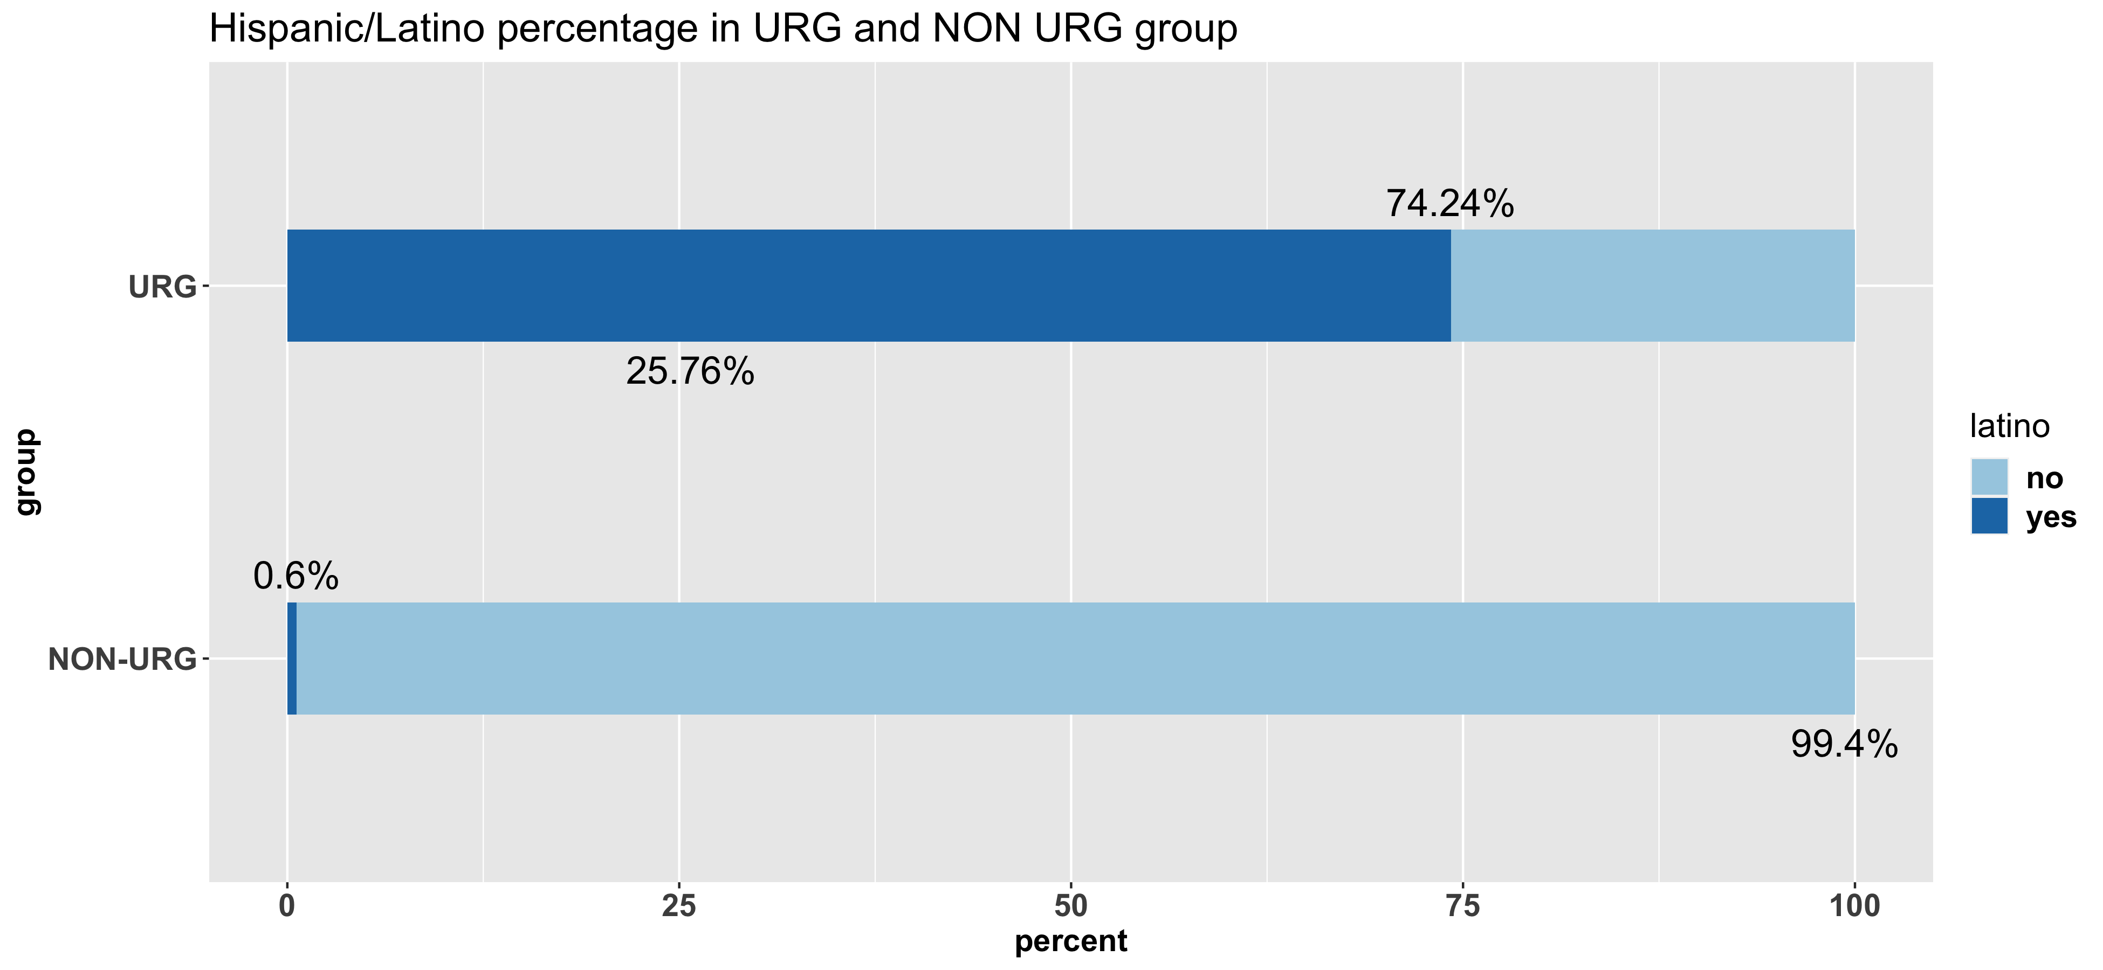


Data Highlights

Slide 7
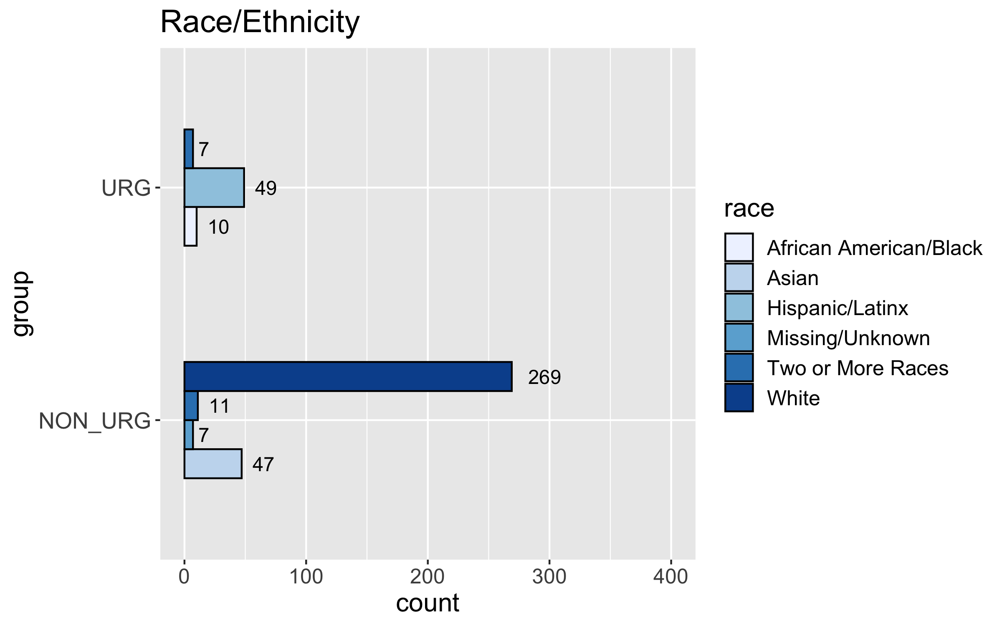
Data Highlights
Data exploratory on Race/Ethnicity between URG and Non URG group

Slide 8
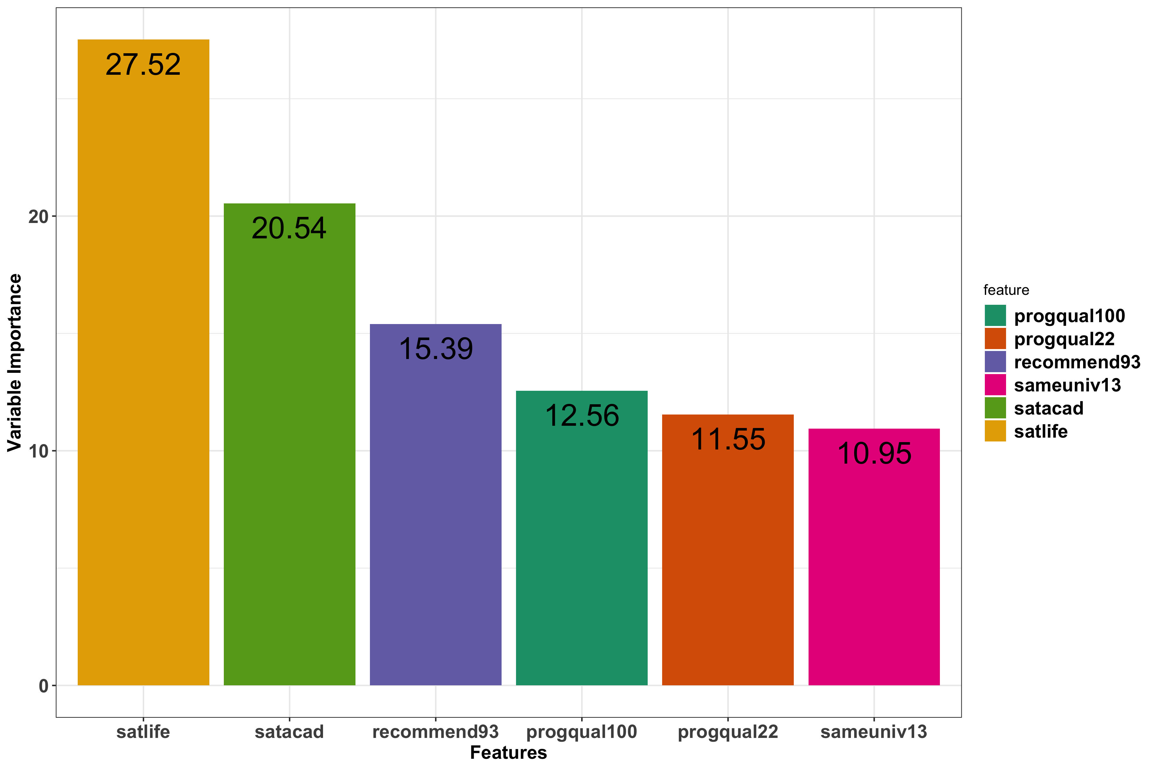
Data Highlights
Feature selection
Using machine learning to find which features is important for overall satisfaction.

Slide 9
Faculty Mentoring and Advising

Slide 10
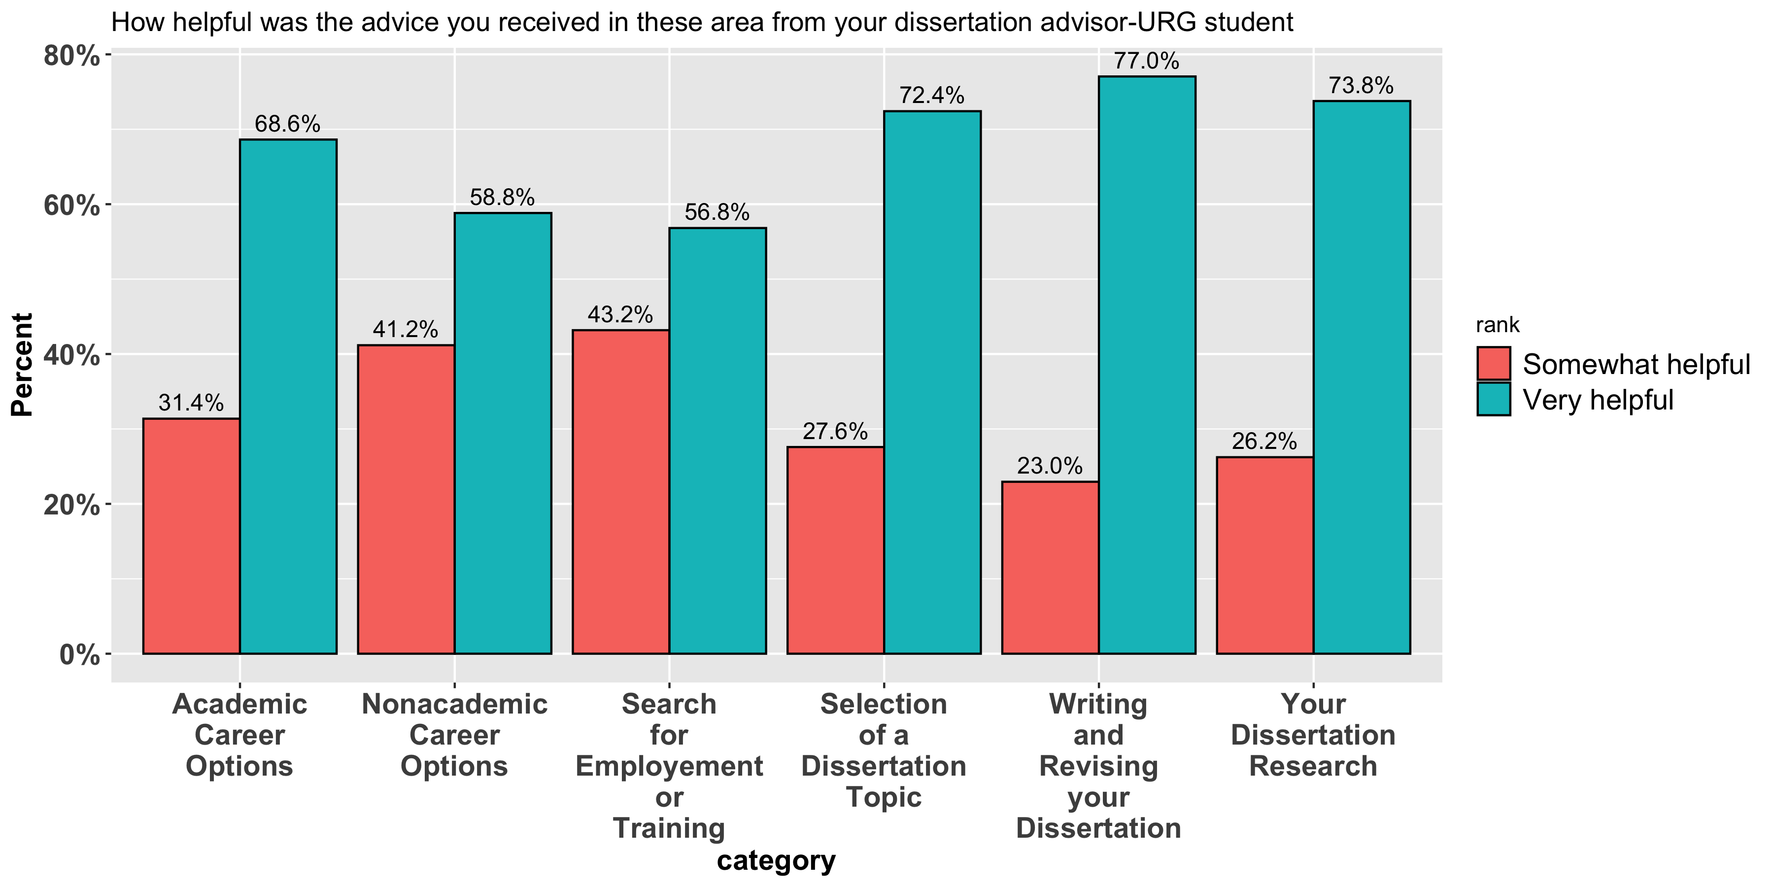
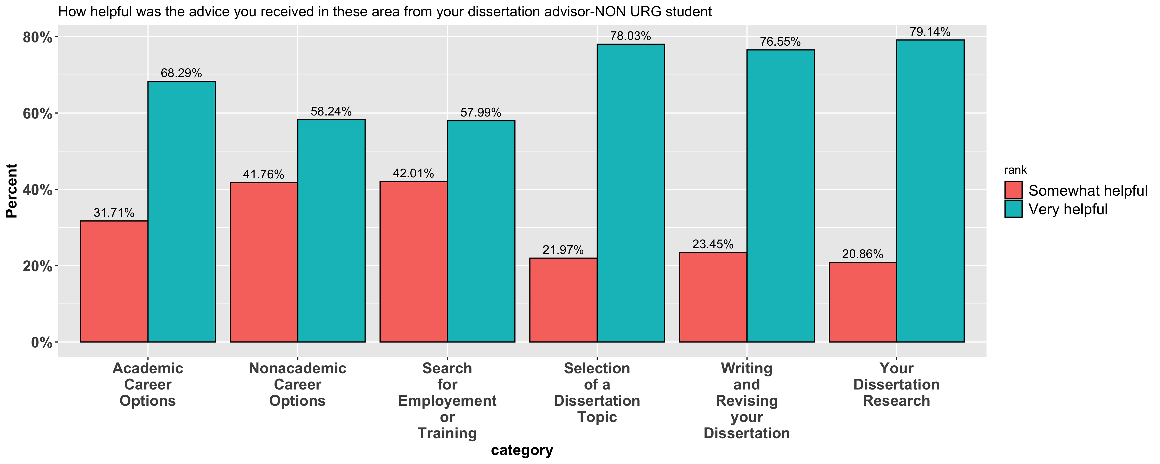
Faculty Mentoring and Advising

Slide 11
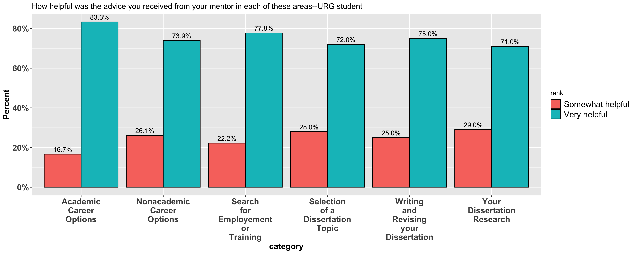
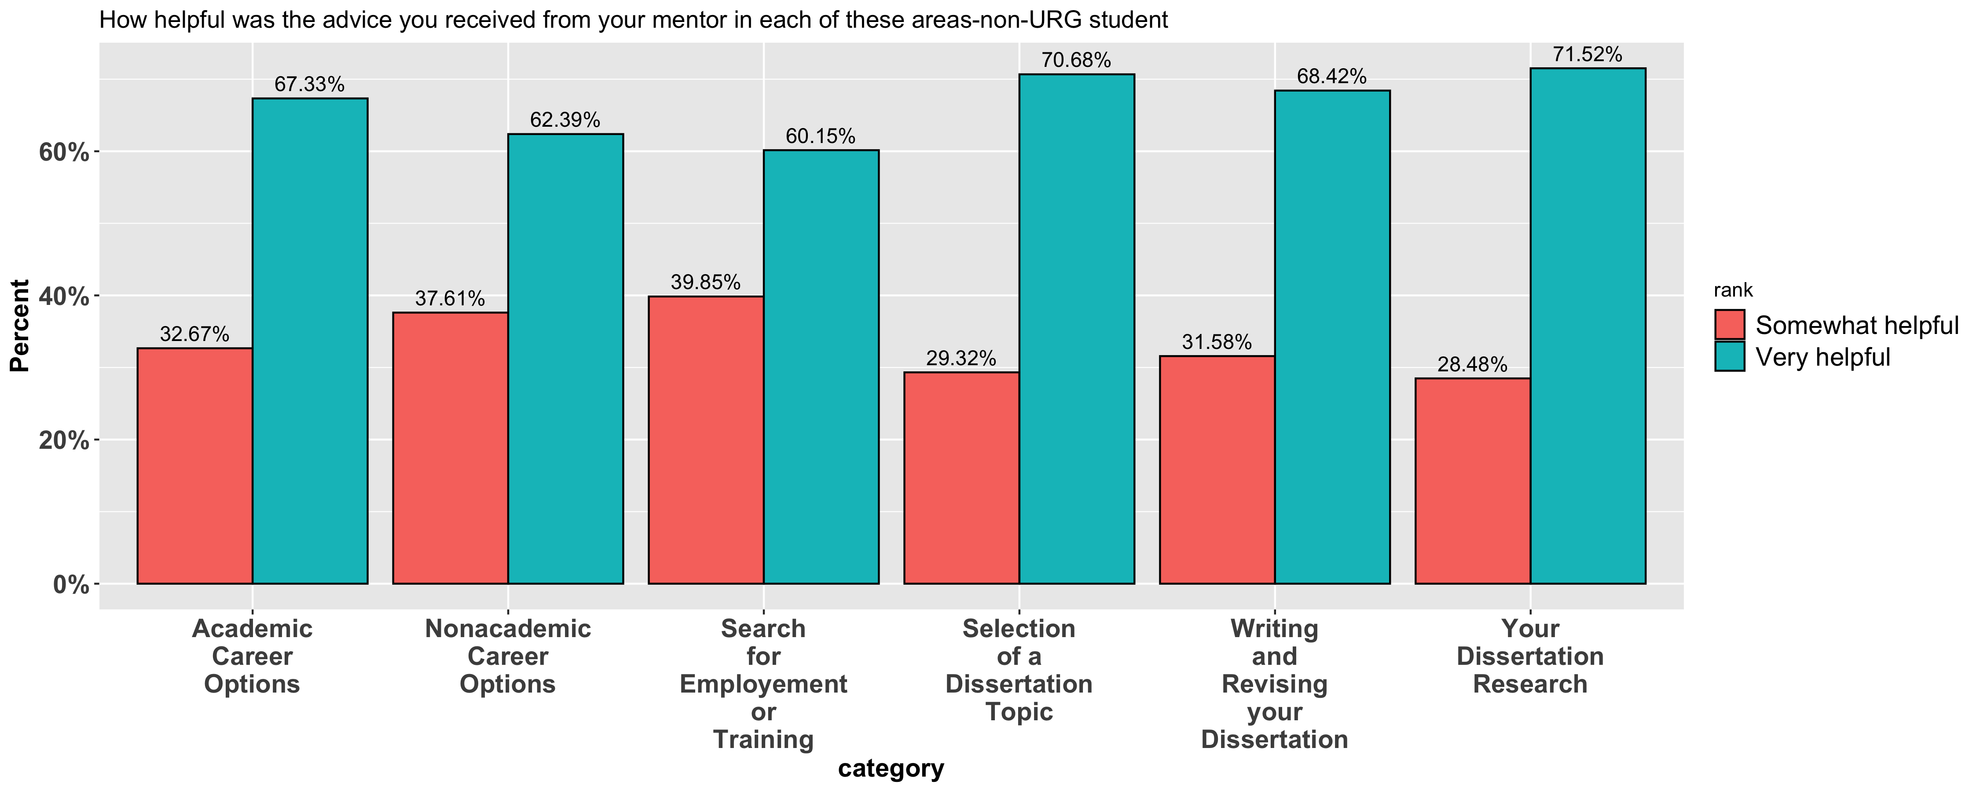
Faculty Mentoring and Advising

Slide 12
Faculty Mentoring and Advising
Pairwise t-test analyzed each of those categories between two groups---the URG group and non-URG group in above two questions ;
The p values are larger than 0.05, meaning there are no significant difference between those categories.

Slide 13
Overall Satisfaction

Slide 14
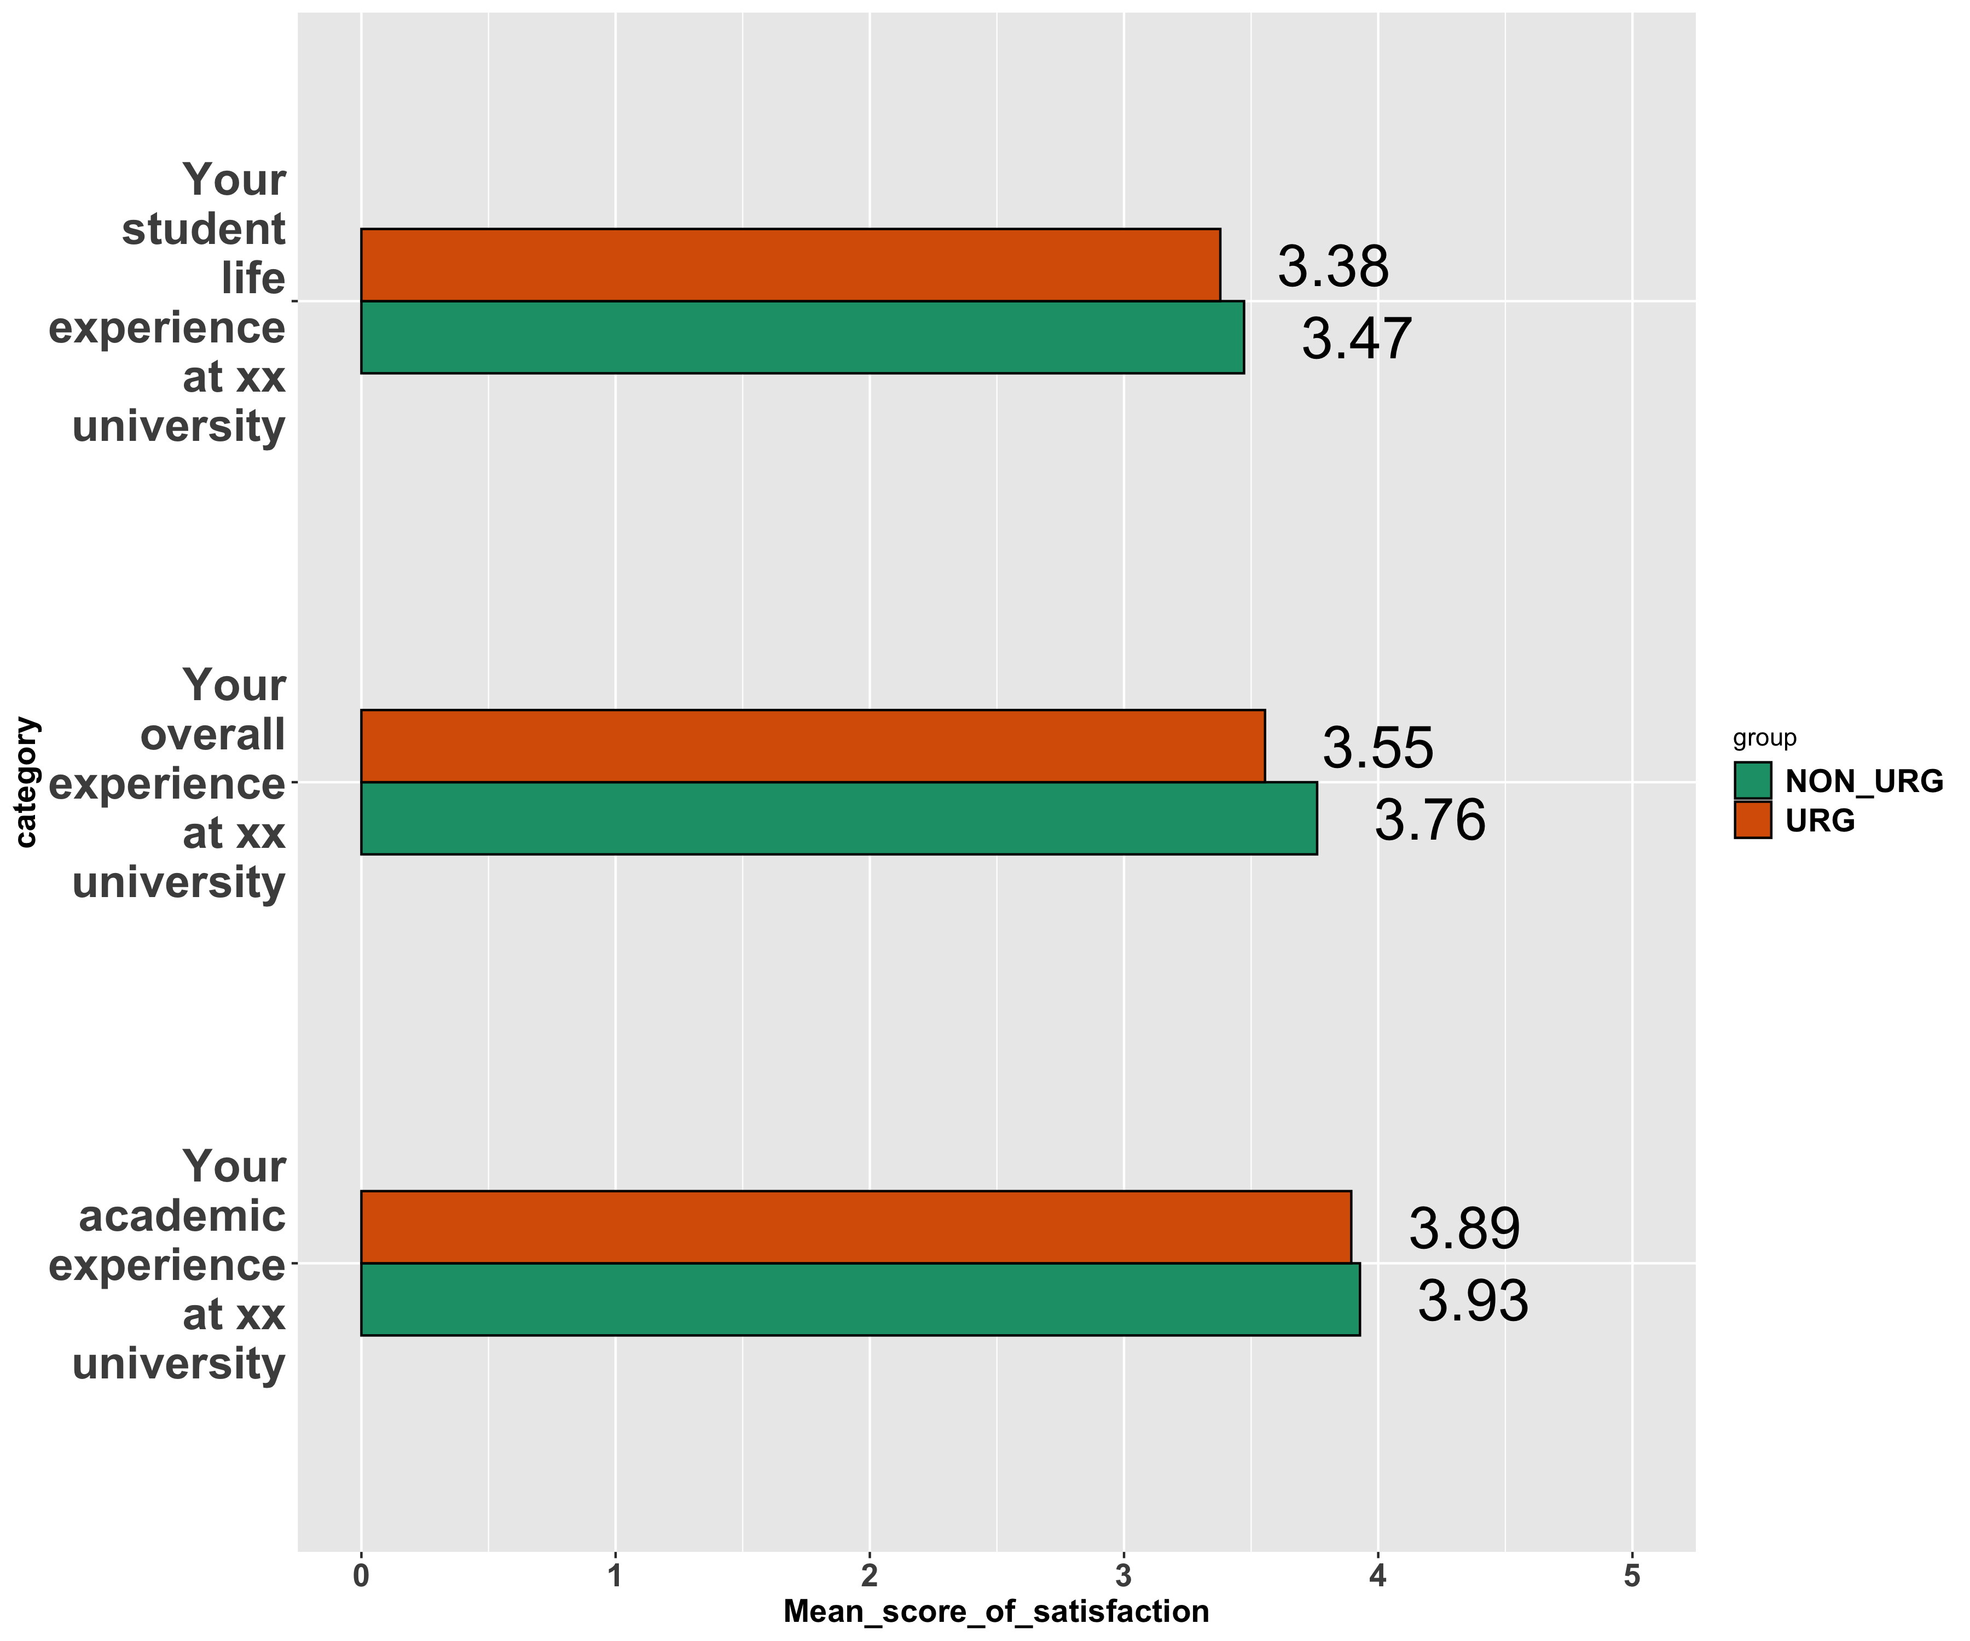
Overall satisfaction
In comparison to their non-URG counterparts:

Slide 15
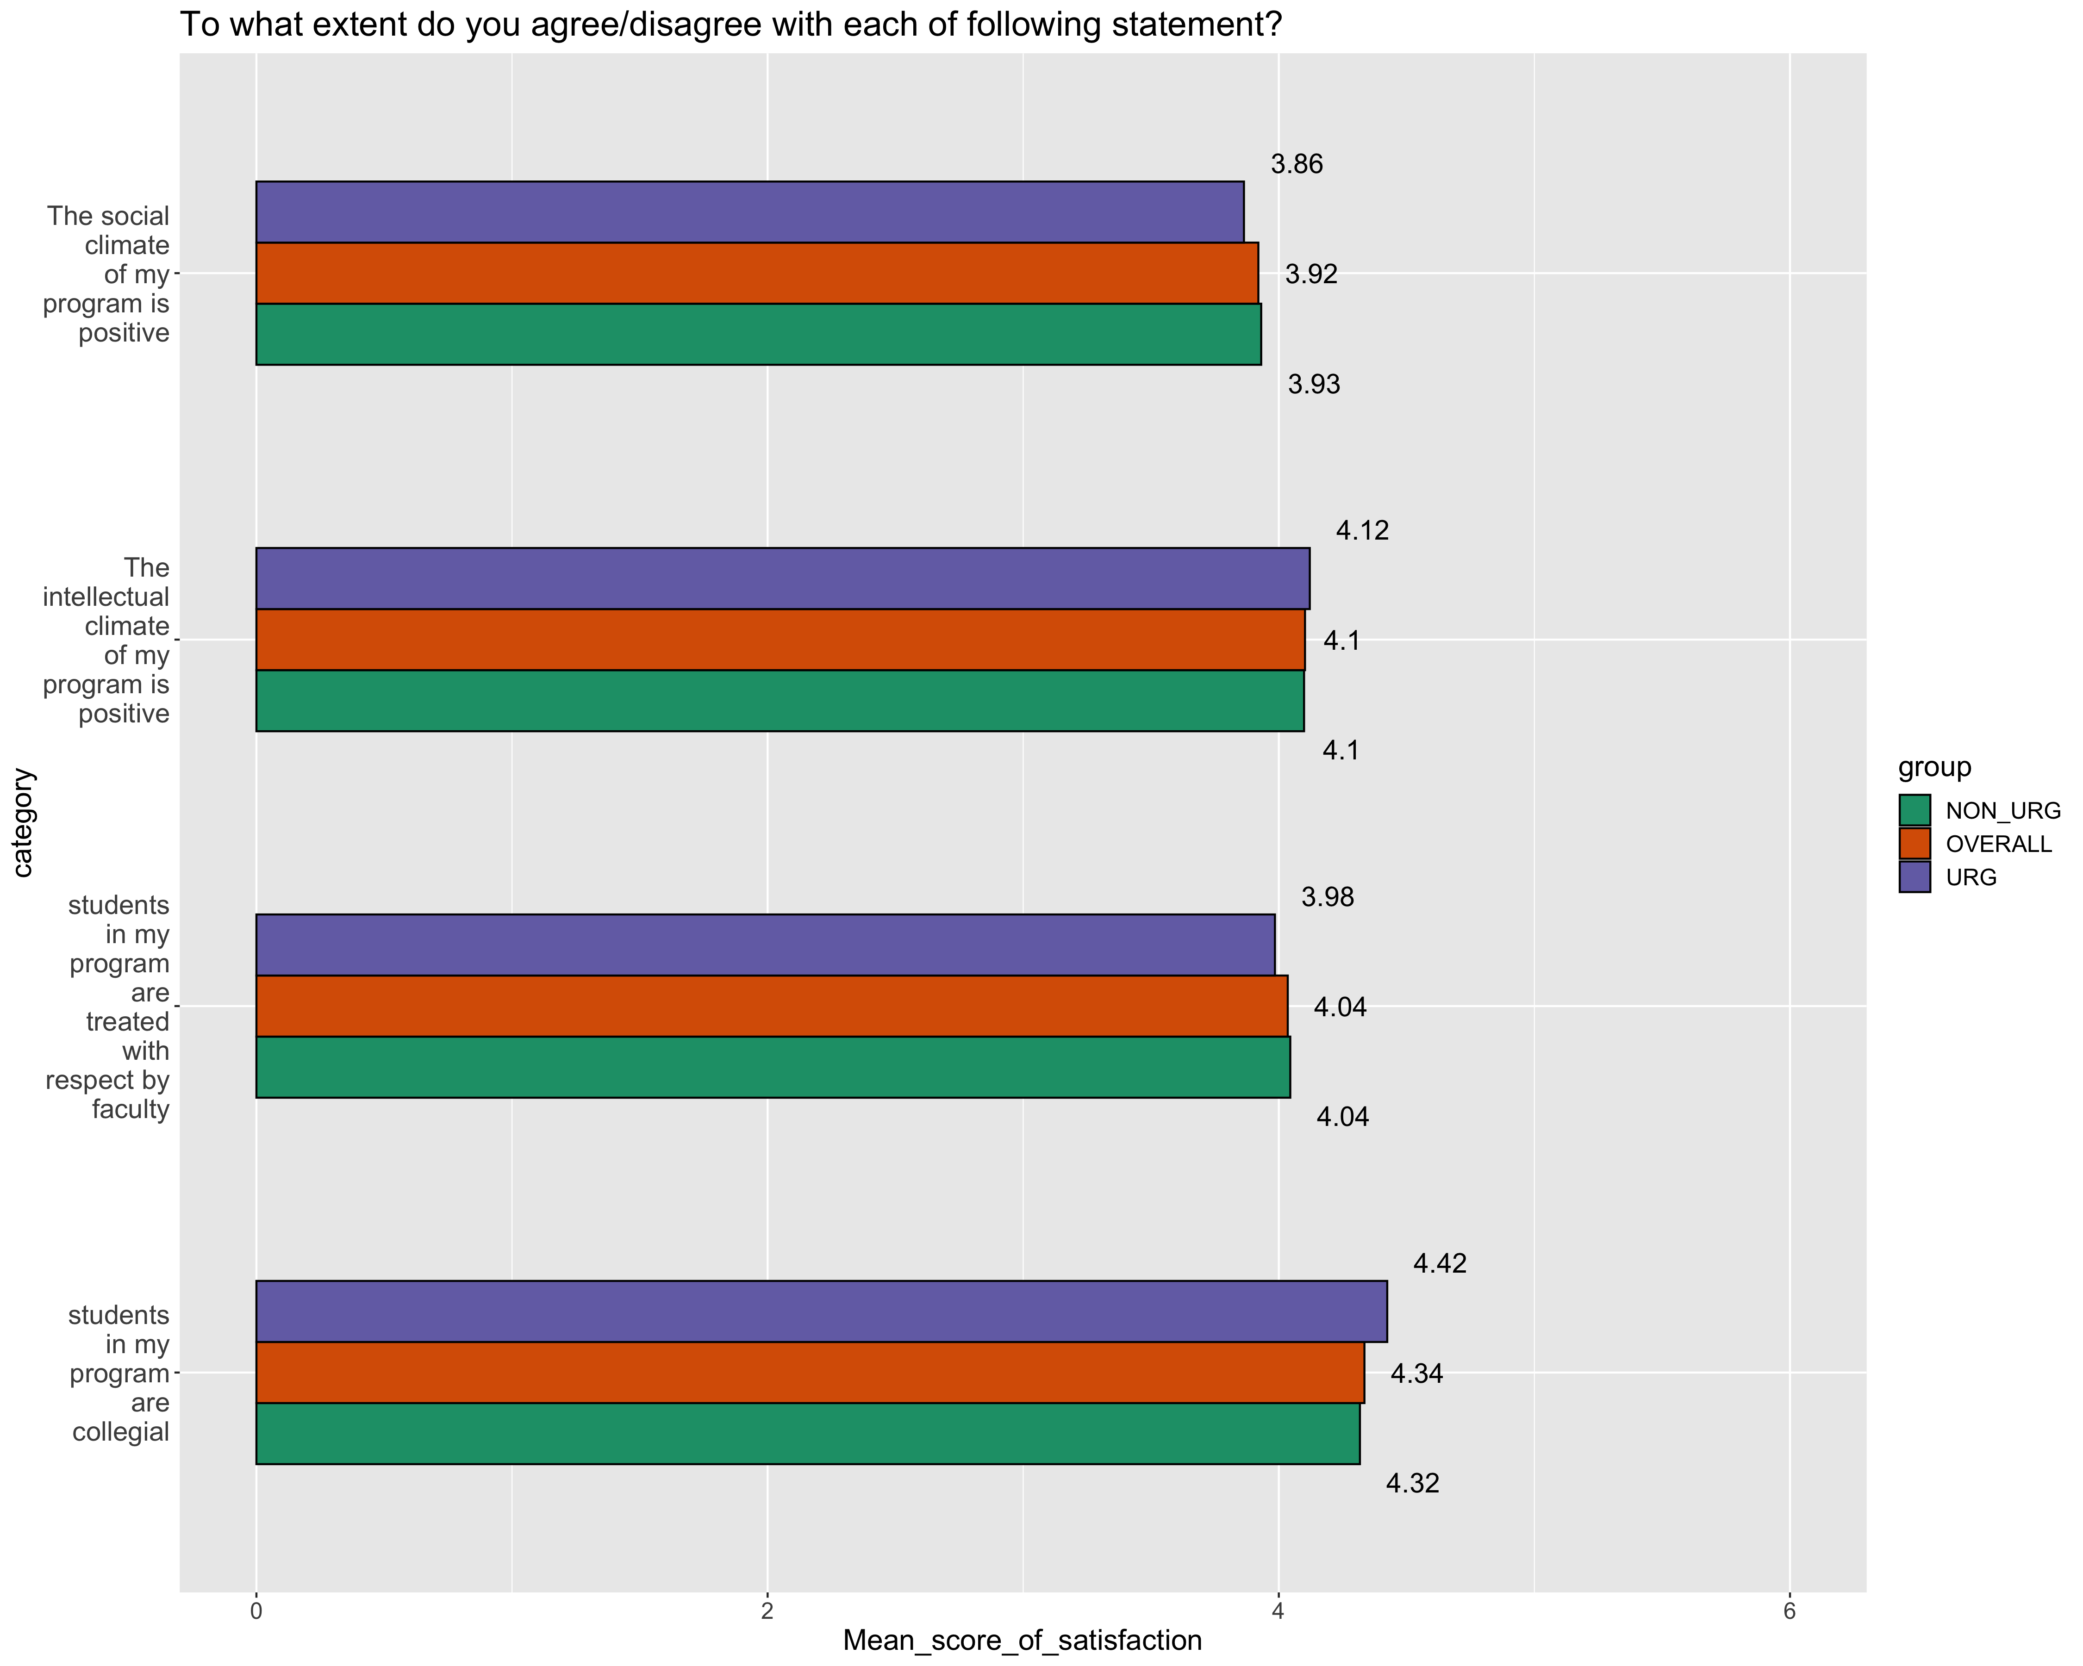
Overall Satisfaction
Convert satisfaction to score(number)

Slide 16
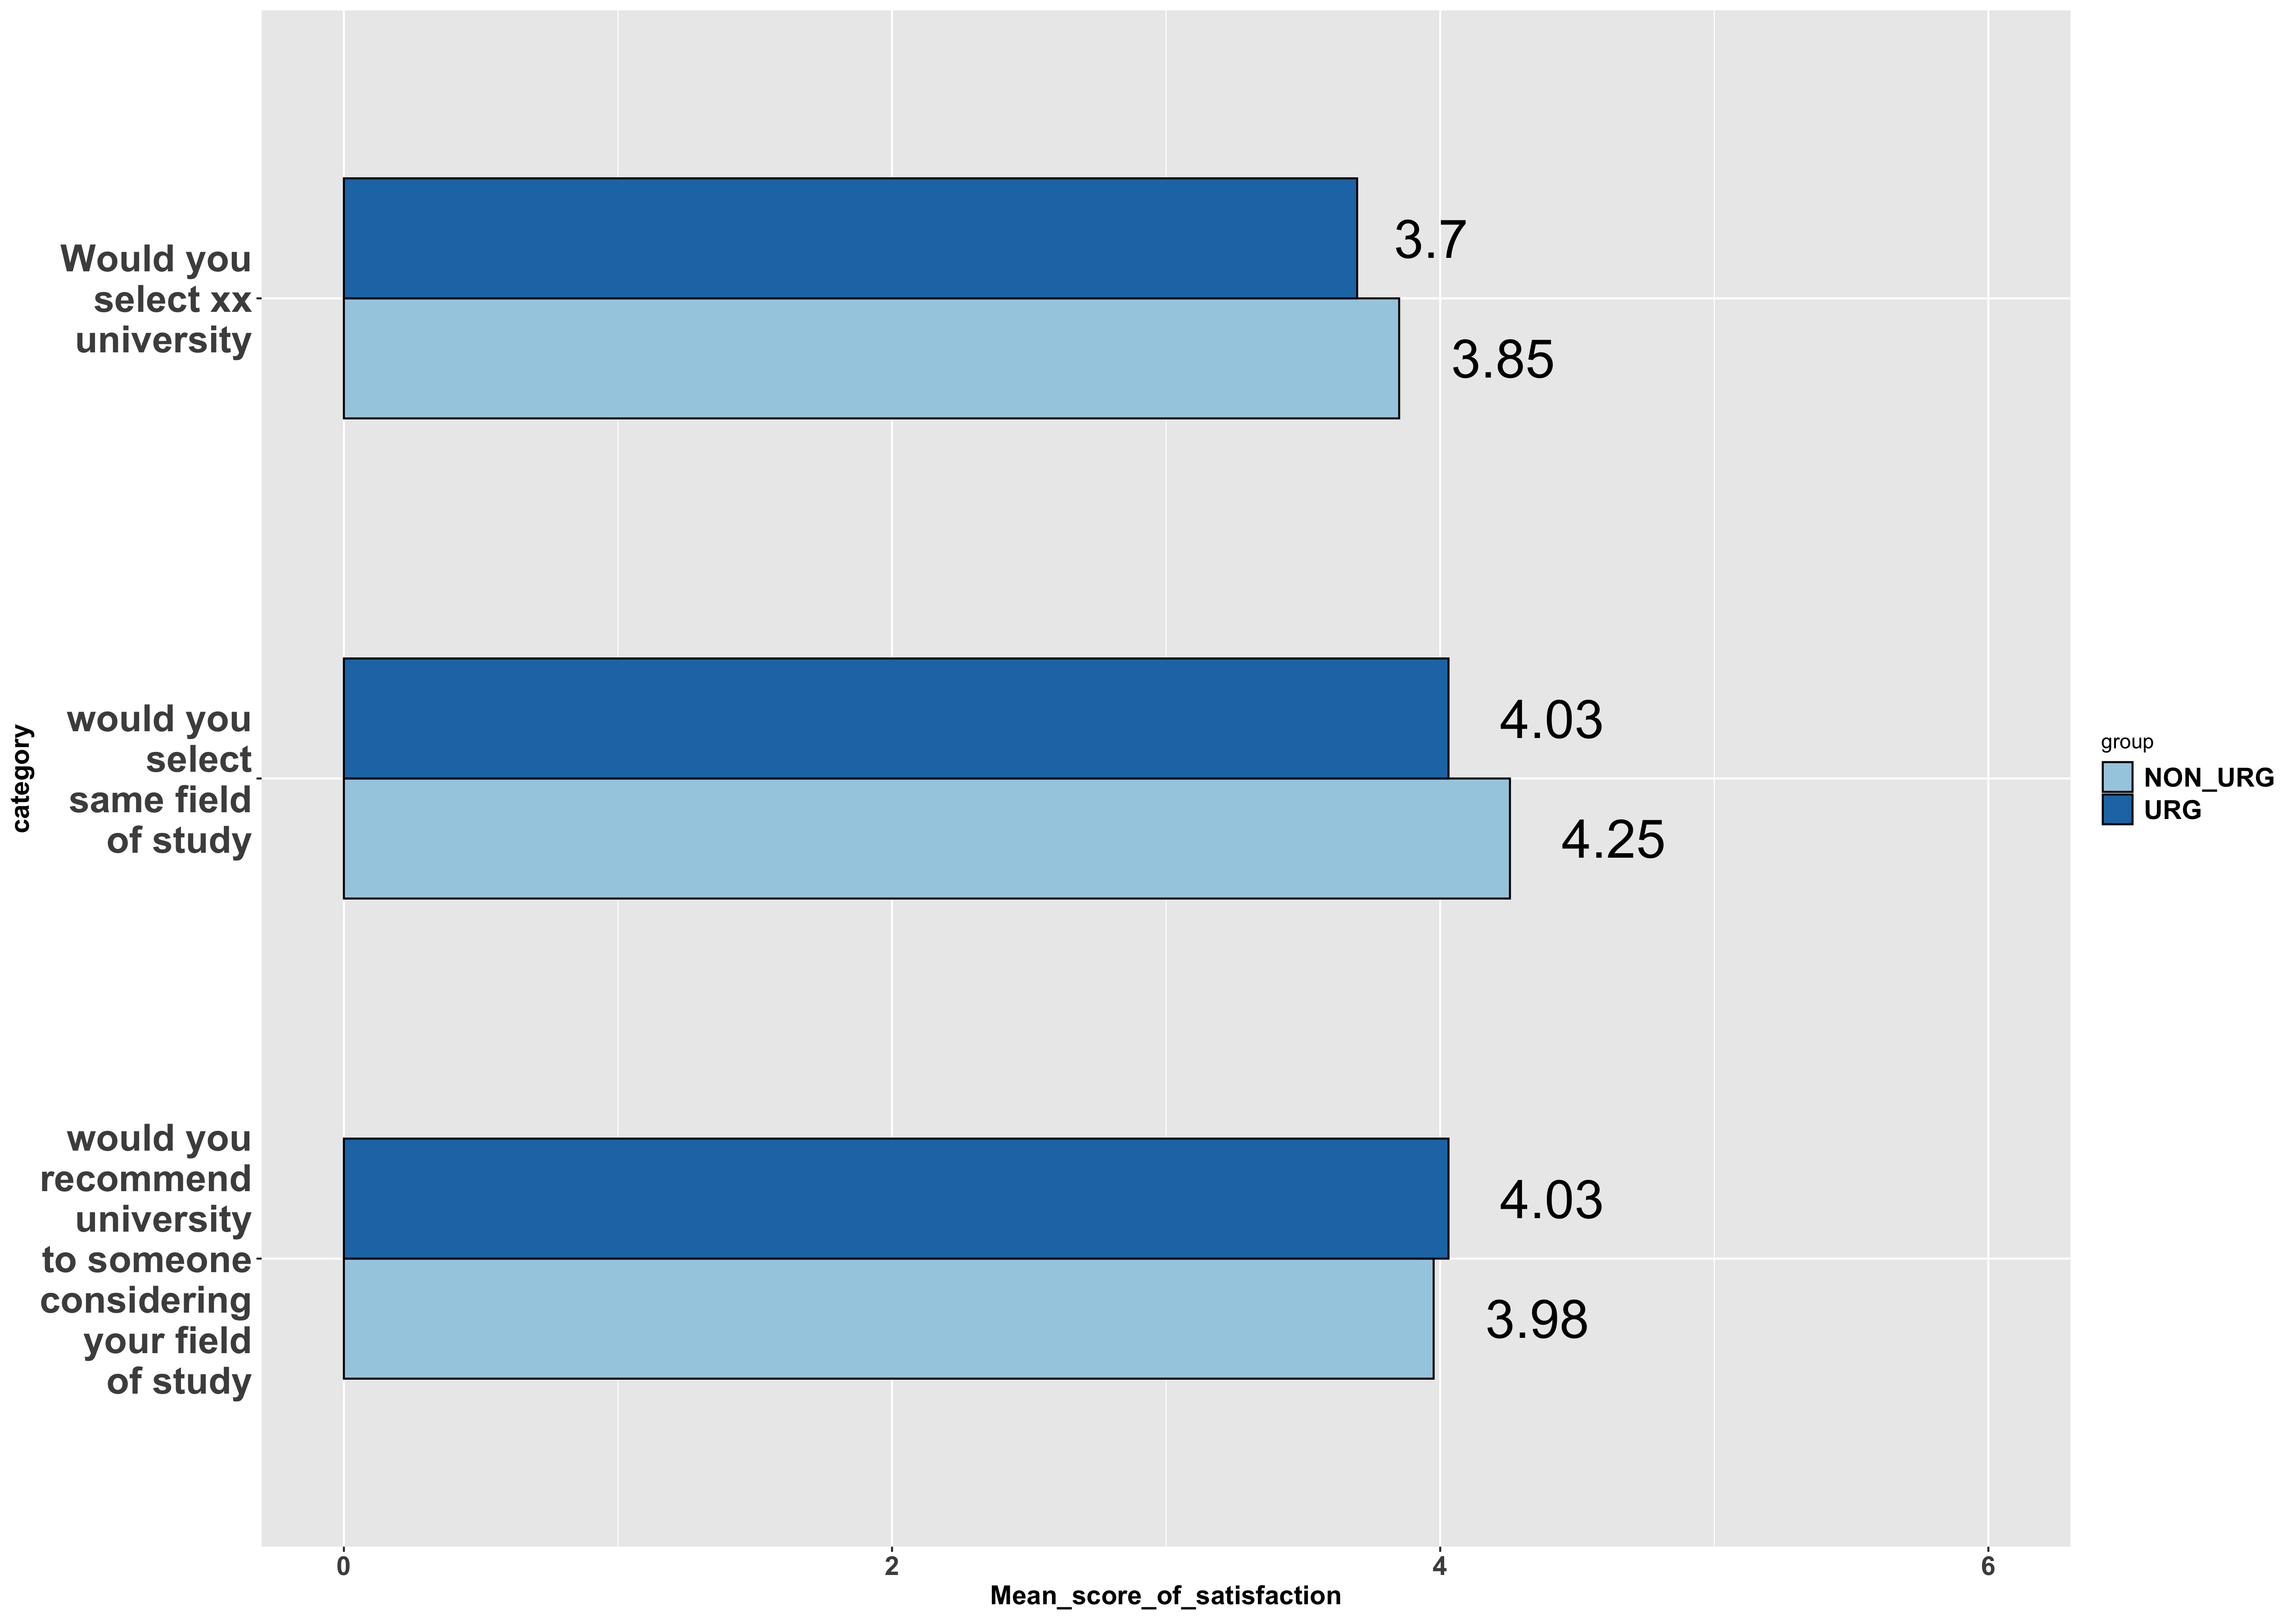
Overall Satisfaction
If you were to start your doctoral career again…

Slide 17
Program Quality

Slide 18
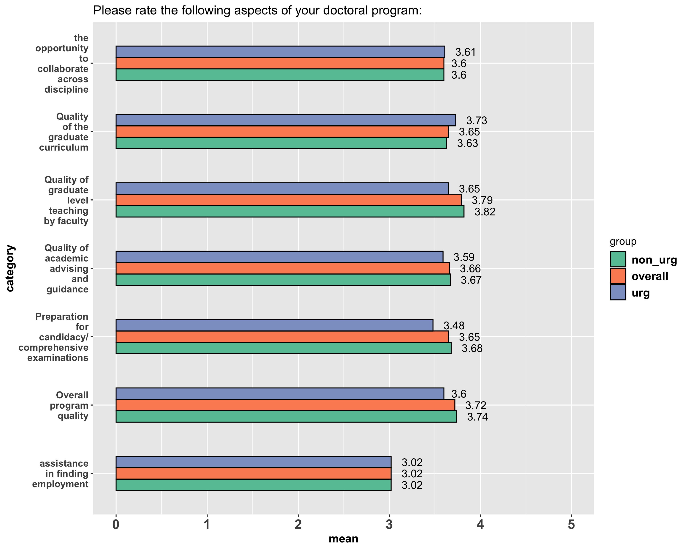
Program Quality

Slide 19
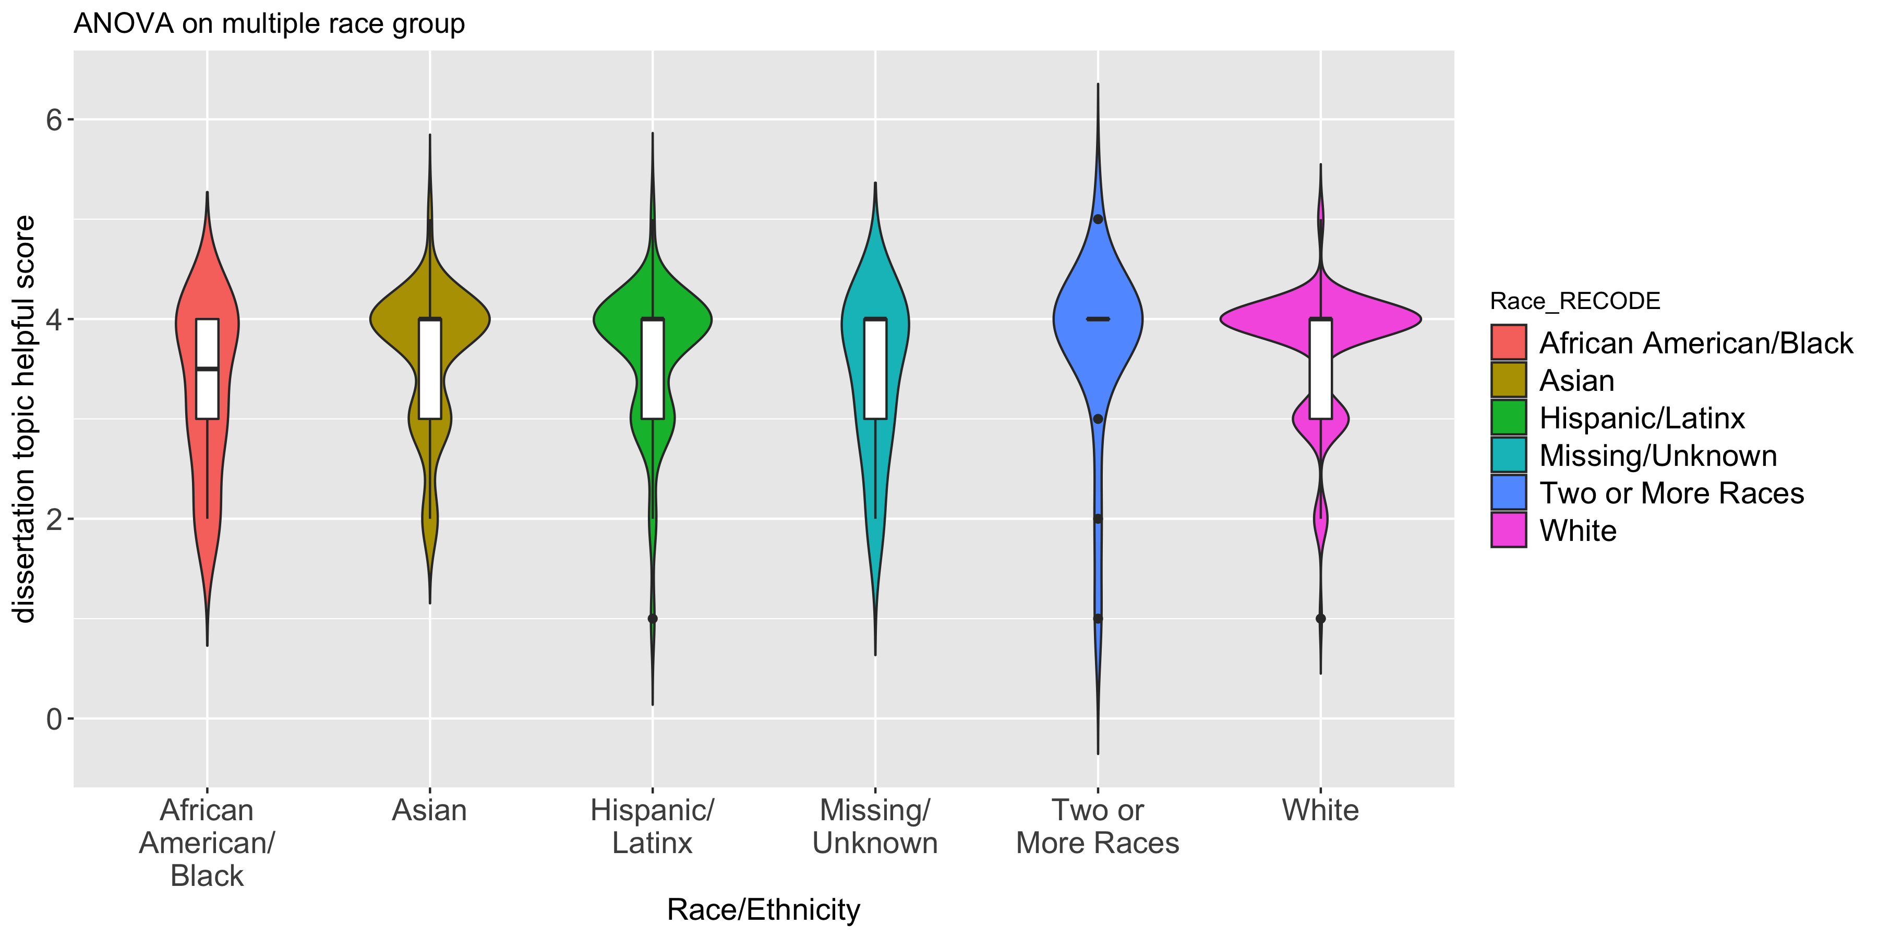
ANOVA analysis
How helpful was the advice you received in dissertation topic selection from your advisor?
I am interested in finding if there is significant difference among multiple ethnicity group.
ANOVA test--for this category, there is no significant difference.

Slide 20
Feature importance…
I am interested in finding which key variables are important features that related to the overall satisfaction.
Pre-process the data for machine learning
Find top 6 variables are: satlife, satacad, recommend93, progqual100, progqual22, and sameuniv13.
Remove high NA rate columns
Reduce unrelated columns
Encode likert scale data
Data imputation

Slide 21
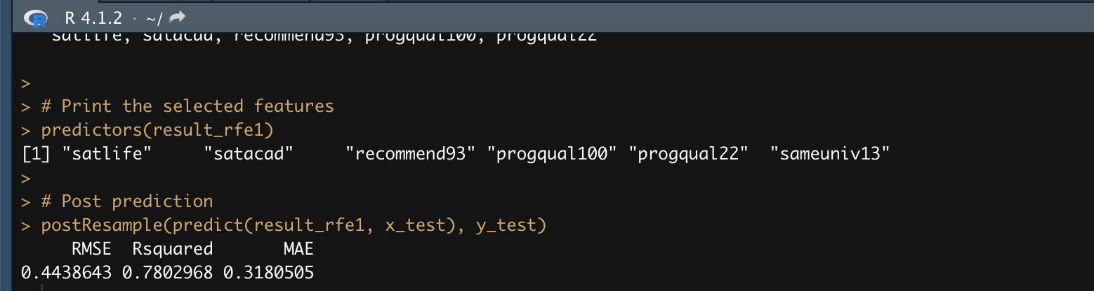
Feature importance
What does these feature means:
satlife: your student life experience at XX university
satacad: your academic experience at XX university
recommend93: would you recommend XX university to someone considering your field of study?
progqual100: Overall program quality
progqual22: Overall program quality
sameuniv13: would you select the same university?

Slide 22
Feature importance
Rsquare = 0.78

Slide 23
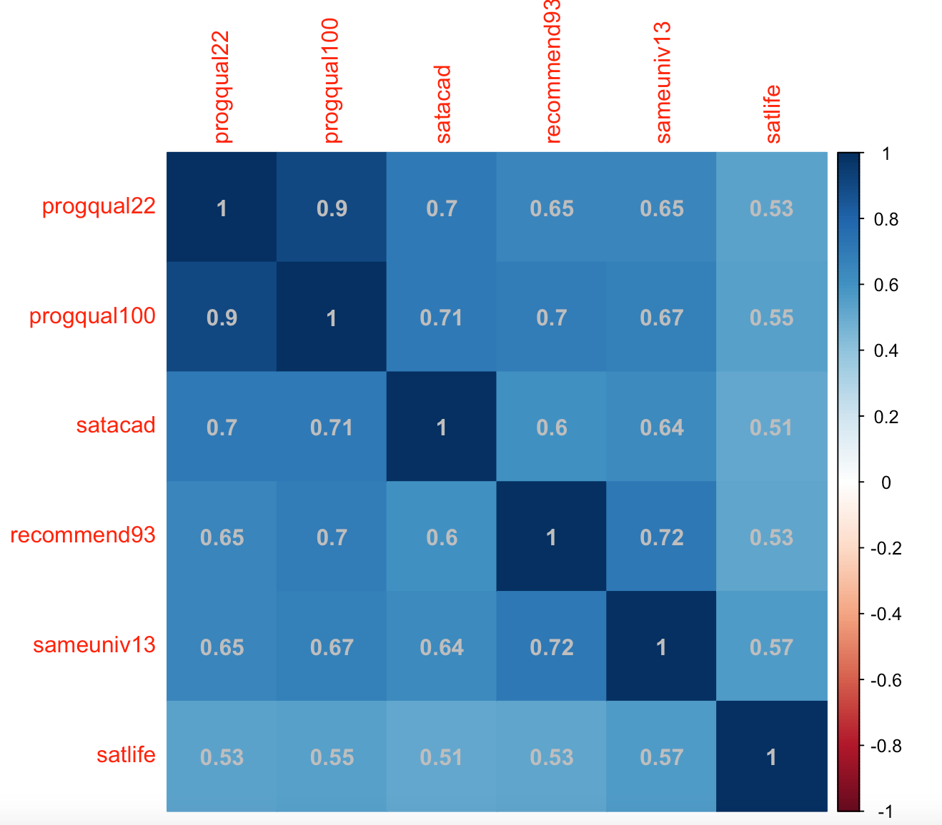
Feature importance

Slide 24
AAU Doctoral Exit Survey Results Methodological Considerations/Technical Notes
Summary
Statistical methods in survey data analysis
What to learn from this analysis?
Get to know the data and do some exploratory analysis
Always pre-process data and clean the data first
Pay attention to details of the analysis
Dealing with NAs and use imputation if needed
Use statistical method
Pairwise
t-test
ANOVA
weighting

